Slide 1

Market News Analysis
Bella Scheer, Tiago Rocha, Baruch Frost

Slide 2
Data Acquisition & Cleaning
Acquired financial news headline data from three sources
CNBC
Guardian
Reuters
Loaded financial news headline data into Pandas DataFrames for sentiment analysis
Acquired financial data from Dow Jones Industrial Average covering the same time frame as the headlines data

Slide 3
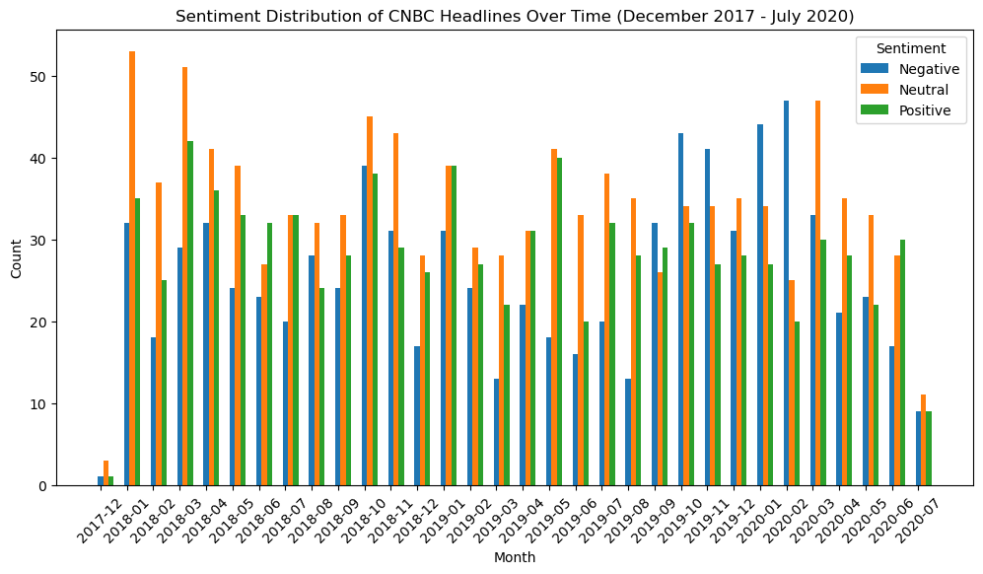
Sentiment Analysis
Researched approaches to perform sentiment analysis in Python
Chose the TextBlob library due to usability
Performed sentiment analysis on the individual headlines and tested averaging over months and days. After experimentation, we determined the daily average data was more robust.

Slide 4
Correlation Analysis
We tested the correlations between the headline data and the DJIA data, first using the default Pearson correlation and then later using Spearman-Rank, which produced better results.
The basic correlation pipeline was split, shift, EMA, and correlation.
We tested multiple values for the split, shift, and EMA with varying results.
We decided to create an automated system to find the optimal split, as well as the optimal shift, and EMA span for each of the split chunks.

Slide 5
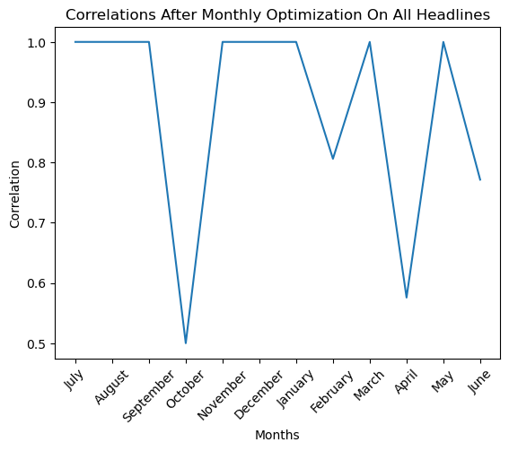
Results
We found that optimal results were achieved by splitting the data into 12 equal chunks (i.e. months).
Our results indicate the news 6-8 days prior was most correlated with a given day’s market movement.
We found that using an exponential moving average (EMA) weakened the correlation with market movement.
We found high correlation between all data sources using the optimized pipeline.

